Slide 1
19Z601- MACHINE LEARNING
UNIT- 3
NEURAL NETWORKS AND DECISION TREES : Feed-forward Networks - Network Training - Delta Rule- Gradient Descent – Error Backpropagation - Regularization in Neural Networks - Generalisation - Decision Tree Learning- Representation - Inductive Bias- Issues (9)
Presented by
Ms.Anisha.C.D
Assistant Professor
CSE

Slide 2
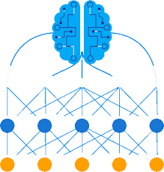
NEURAL NETWORKS
Artificial neural networks (ANNs) provide a general, practical method for learning real-valued, discrete-valued, and vector-valued functions from examples.
Algorithms such as BACKPROPAGATION use gradient descent to tune network parameters to best fit a training set of input-output pairs.
ANN learning is robust to errors in the training data and has been successfully applied to problems such as interpreting visual scenes, speech recognition, and learning robot control strategies.

Slide 3
INTRODUCTION
Neural network learning methods provide a robust approach to approximating real-valued, discrete-valued, and vector-valued target functions.
For certain types of problems, such as learning to interpret complex real-world sensor data, artificial neural networks are among the most effective learning methods currently known.
For example, the BACKPROPAGATION algorithm has proven surprisingly successful in many practical problems :
such as learning to recognize handwritten characters
learning to recognize spoken words
and learning to recognize faces

Slide 4
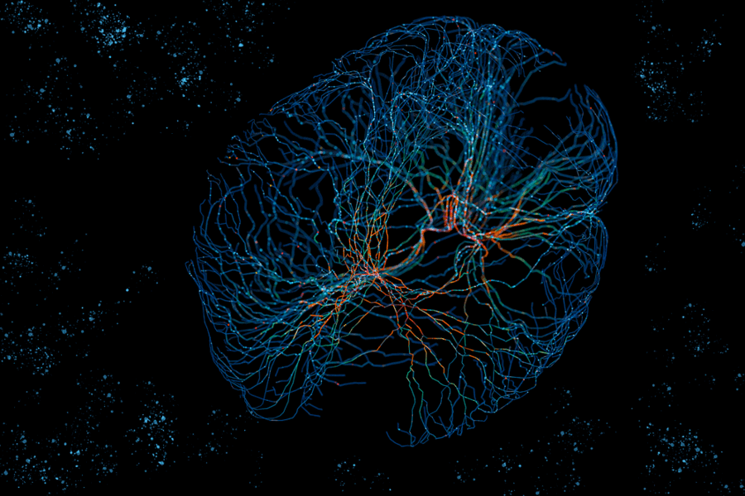
BIOLOGICAL MOTIVATION
The study of artificial neural networks (ANNs) has been inspired in part by the observation that biological learning systems are built of very complex webs of interconnected neurons.
In rough analogy, artificial neural networks are built out of a densely interconnected set of simple units, where each unit takes a number of real-valued inputs (possibly the outputs of other units) and produces a single real-valued output (which may become the input to many other units).

Slide 5
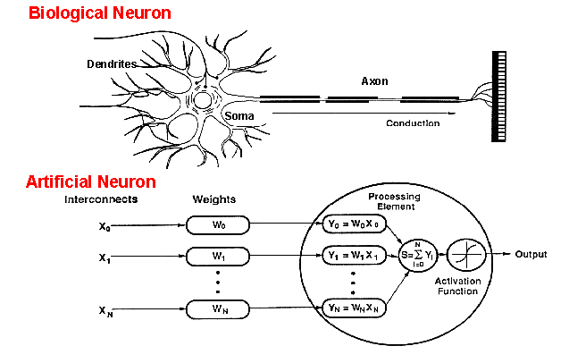
BIOLOGICAL MOTIVATION – HOW DO ANN WORK?

Slide 6
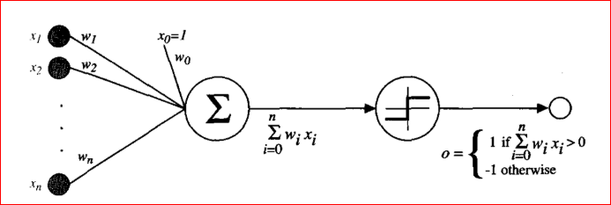
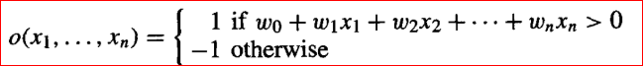
PERCEPTRON
One type of ANN system is based on a unit called a perceptron.
A perceptron takes a vector of real-valued inputs, calculates a linear combination of these inputs, then outputs a 1 if the result is greater than some threshold and -1 otherwise.

Slide 7
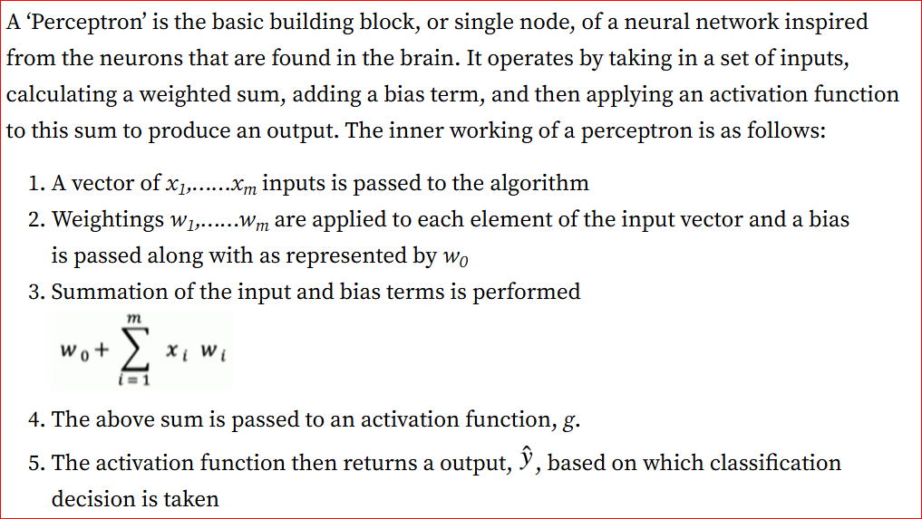
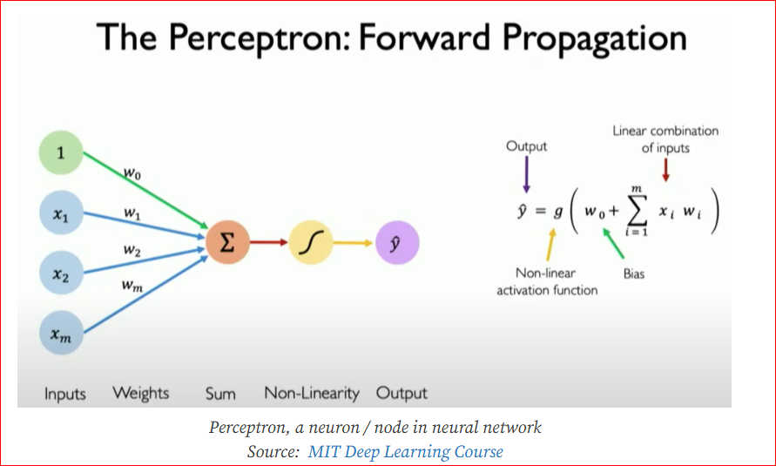
INNER WORKING OF PERCEPTRON

Slide 8
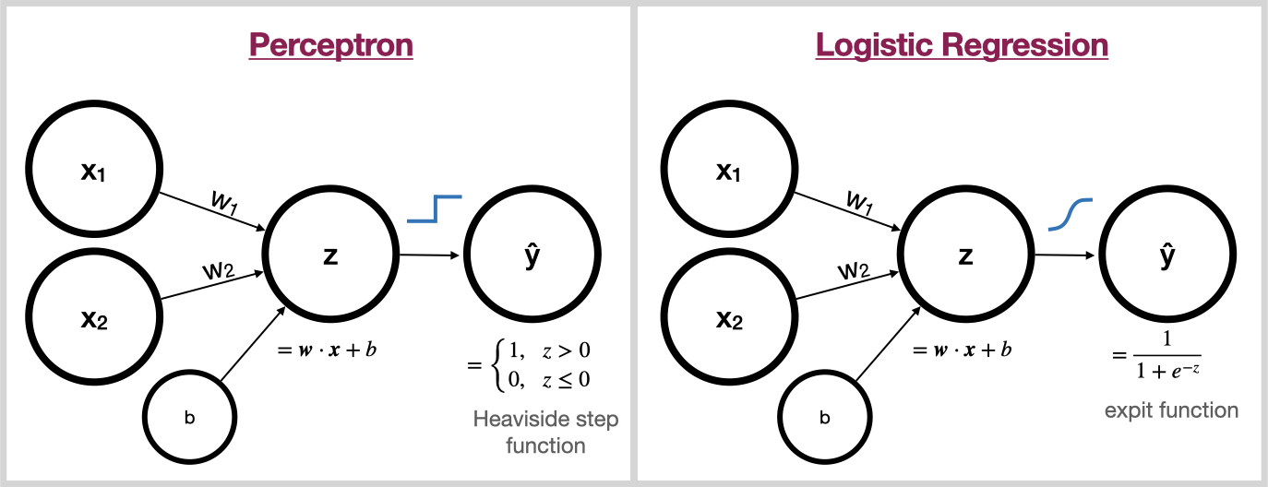
Perceptron Vs Logistic Regression Representation as Perceptron

Slide 9
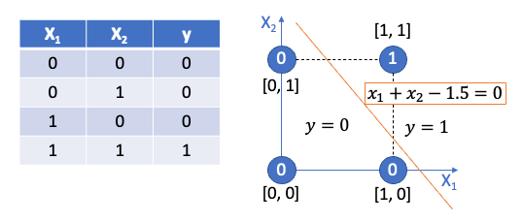
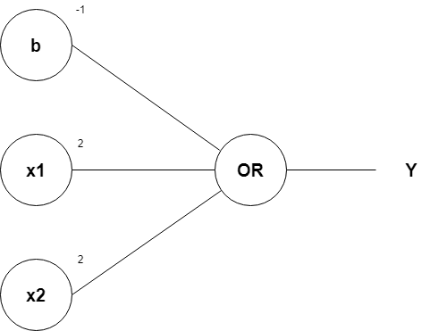
EXAMPLE : AND GATE REPRESENTATION

Slide 10
HOMEWORK
Represent OR, NAND, NOR, XOR in graph as shown in previous slide.
Find out if its linearly separable.
If yes represent using perceptron

Slide 11
PERCEPTRON TRAINING RULE
Main Objective : To determine a weight vector that causes the perceptron to produce the correct +/-1 output for each of the given training examples.
Several algorithms are known to solve this learning problem.
Here two algorithms are considered:
The perceptron rule and (suitable for linearly separable)
The delta rule

Slide 12
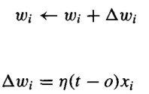
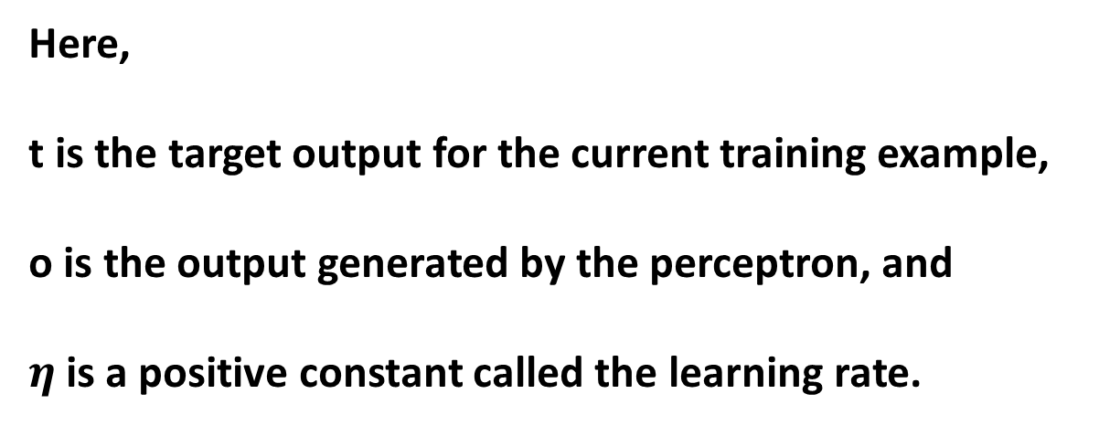
PERCEPTRON TRAINING RULE: PERCEPTRON RULE
Here,
t is the target output for the current training example,
o is the output generated by the perceptron, and
$η$is a positive constant called the learning rate.

Slide 13
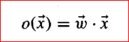
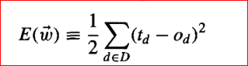
PERCEPTRON TRAINING RULE: DELTA RULE (GRADIENT DESCENT)
Step 1 : First stage of Perceptron : Linear Unit
Step 2 : Specifying a measure for the training error of a hypothesis (weight vector)
where D is the set of training examples,
t_{d} is the target output for training example d, and
o_{d} is the output of the linear unit for training example d.

Slide 14
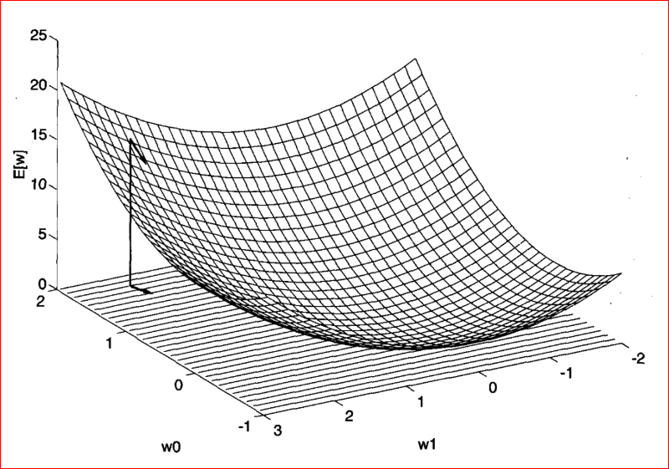
VISUALIZING THE HYPOTHESIS SPACE
To visualize the entire hypothesis space of possible weight vectors and their associated E values

Slide 15
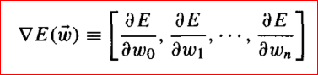
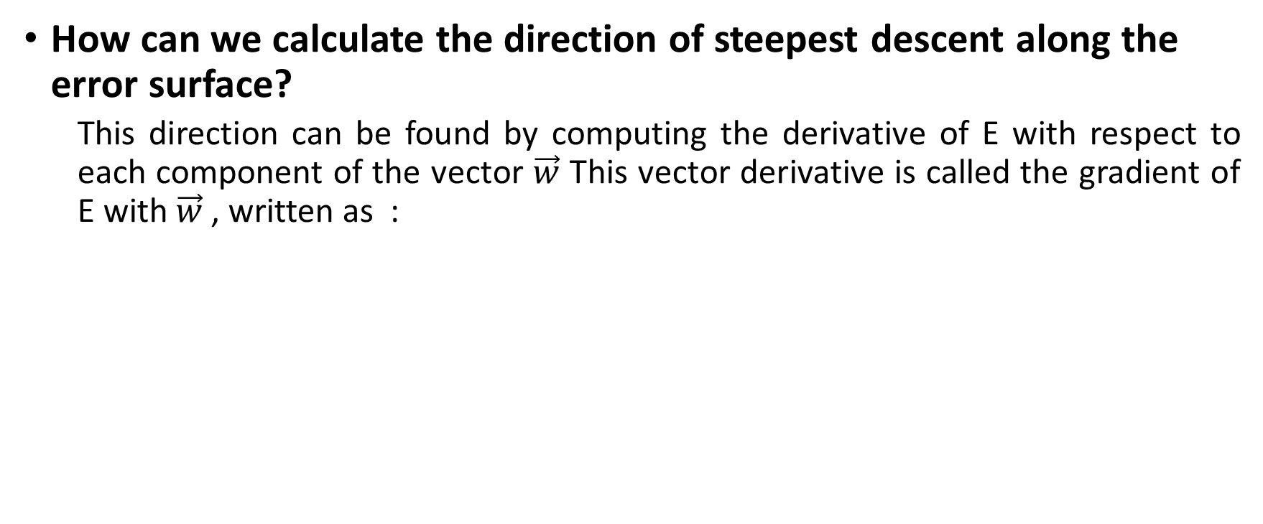
DERIVATION OF GRADIENT DESCENT
How can we calculate the direction of steepest descent along the error surface?
This direction can be found by computing the derivative of E with respect to each component of the vector $\vec{w}$ This vector derivative is called the gradient of E with $\vec{w}$ , written as :
When interpreted as a vector in weight space, the gradient specifies the direction that produces the steepest increase in E. The negative of this vector therefore gives the direction of steepest decrease.

Slide 16
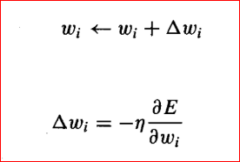
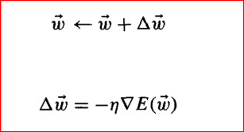
DERIVATION OF GRADIENT DESCENT
Step 4 : The training rule for gradient descent is

Slide 17
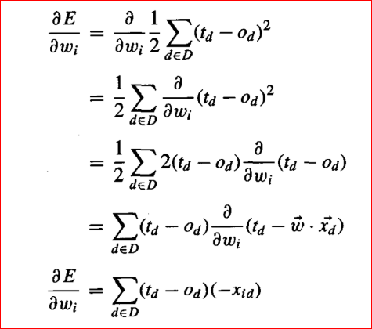
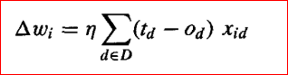
DERIVATION OF GRADIENT DESCENT

Slide 18
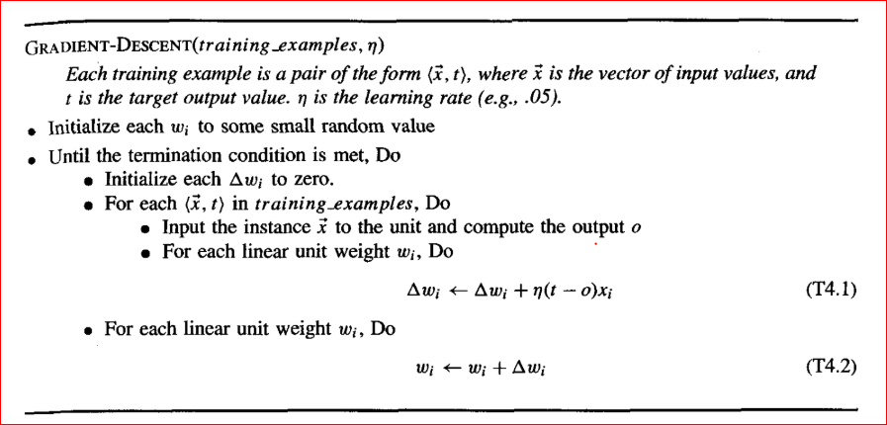
GRADIENT DESCENT ALGORITHM

Slide 19
PERCEPTRON RULE VS GRADIENT DESCENT RULE
PERCEPTRON RULE | GRADIENT DESCENT RULE
Begin with random weights, then iteratively apply the perceptron rule to each training example, modify the perceptron weights whenever it misclassifies an example. | Begin with random weight vector, apply the linear unit to all training examples, then compute weight update rule for each weight.
If the data are not linearly separable, convergence is not assured. | If the data are not linearly separable, convergence is assured.

